Slide 1








Shopee Surplus
DATA
ANALYSIS
Joshua Eirus Candido

Slide 2



Our Shopee Surplus Data
Brief Intro
Mochi-Mochi
Anik-Anik Surplus
ANALYSIS
Joshua Eirus Candido

Slide 3

Our Shopee Surplus Data
Brief Intro
Products
Mochi-Mochi
Anik-Anik Surplus
Japan Supplier
United Kingdom
Supplier
United States
Supplier
ANALYSIS
Joshua Eirus Candido

Slide 4
Our Shopee Surplus Data
Mochi-Mochi
Anik-Anik Surplus
Brief Intro
United Kingdom
Supplier
United States
Supplier
Common
Japan Supplier
Products
ANALYSIS
Joshua Eirus Candido

Slide 5



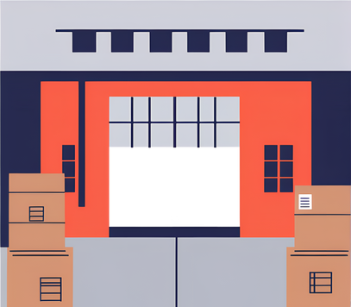
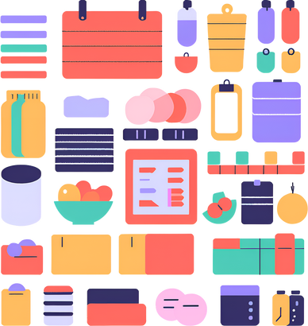
Our Shopee Surplus Data
Mochi-Mochi
Anik-Anik Surplus
Brief Intro
Process
Common
Products
Ceramics
Toys
Branded Mugs
Picture frames
Vinyl Records
Trinkets
Anime merch
Smartphone Cases
Music Box
School Supplies
Electronics
Themed Tin Cans
Joshua Eirus Candido

Slide 6




Our Shopee Surplus Data
Mochi-Mochi
Anik-Anik Surplus
Brief Intro
Common
Products
Process
Pack & Deliver
Live sell
Resupply
Sort
Ceramics
Joshua Eirus Candido
Toys
Branded Mugs
Picture frames
Vinyl Records
Trinkets
Anime merch
Smartphone Cases
Music Box
School Supplies
Electronics
Themed Tin Cans

Slide 7
Our Shopee Surplus Data
Mochi-Mochi
Anik-Anik Surplus
Brief Intro
Common
Products
Process
Pack & Deliver
Live sell
Resupply
Sort
Ceramics
Joshua Eirus Candido
Toys
Branded Mugs
Picture frames
Vinyl Records
Trinkets
Anime merch
Smartphone Cases
Music Box
School Supplies
Electronics
Themed Tin Cans

Slide 8

Common
Trends
Products
General Income
2022
Resupply
Pack & Deliver
Live sell
Sort
Toys
General Income
2023
Process
Branded Mugs
Picture frames
Vinyl Records
Trinkets
Anime merch
Smartphone Cases
Music Box
School Supplies
Electronics
Themed Tin Cans

Slide 9
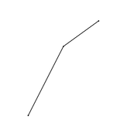
Data Overview
The data was extracted from our Shopee Seller’s account or page website.
No duplicate data appeared but still performed drop duplicates in both Python and Excel just to be sure.
Using Power Query, the monthly completed orders data were merged.
Issue encountered:
The “Tracking Number” column appeared as a decimal number. (e.g., 7.85349E+11)
Fixed it by changing its data type to text. (Tracking Number now: 785348988418)
No further issues were detected with data extraction, transformation, and load (ETL).
ran df.describe() to get their statistics, df.dtypes for checking their data types, df.head() to check the first few columns, and ensure no anomaly was present.
The rest of the added columns (“LISTING”, and “LIVE”) were filters I created according to my need for this presentation.

Slide 10
Data Overview
Scope
The data’s only coverage is one (1) surplus store.
As previously discussed, there are various items from different industries (we are calling them “item categories” for this presentation) from the shop but these shall only be perceived as a surplus item.
The shop’s only location is at Marilao, Bulacan, Philippines but orders are shipped nationwide or as far as Shopee’s delivery reach.
Limitation
Shopee does not allow the sharing of customer’s demographics. Otherwise, it would have been crucial for discovering customer patterns.
Since there are several distinct items and only a handful of employees running the business, it is difficult to keep track which item category (frames, ceramics, toys, etc.,) is being sold.

Slide 11
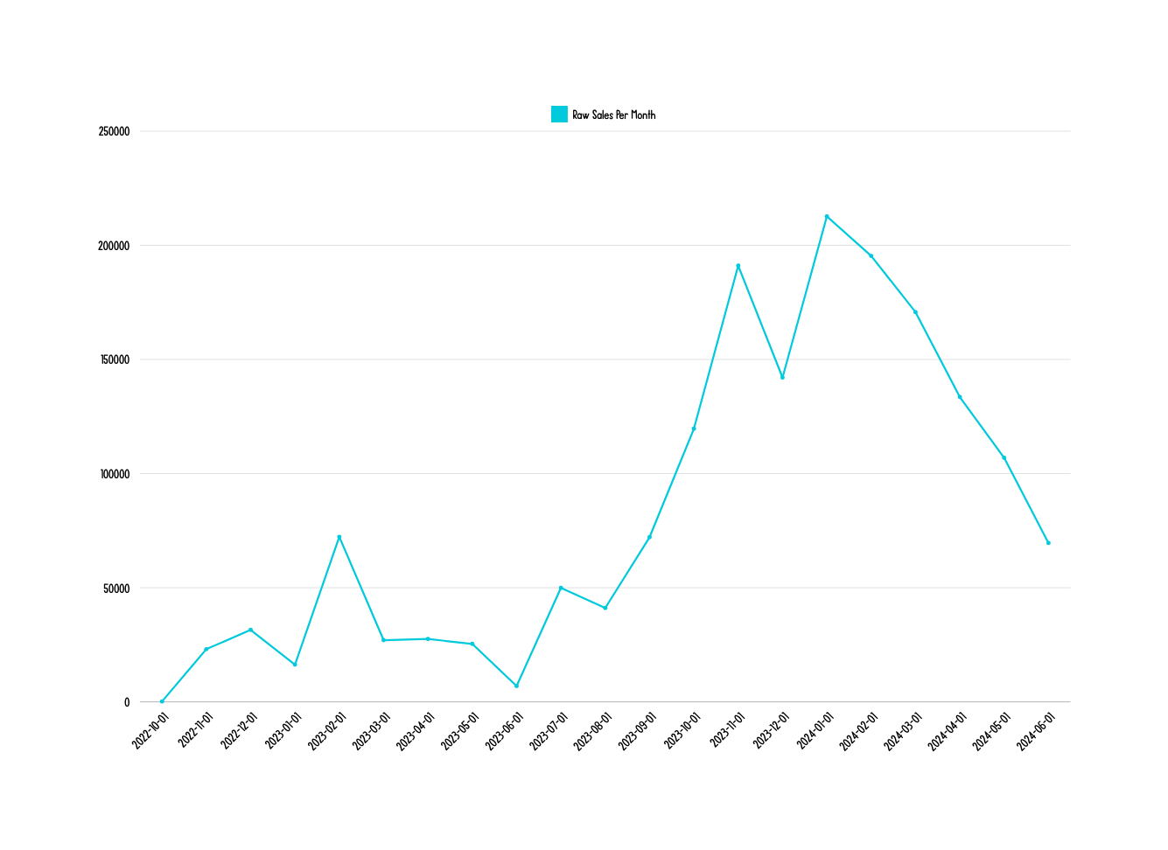

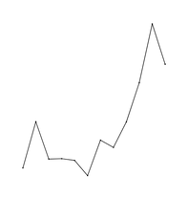

Trends
Raw Sales
2022
Raw Sales
2023
Raw Sales
2024
Raw Sales
(2022-June2024)

Slide 12
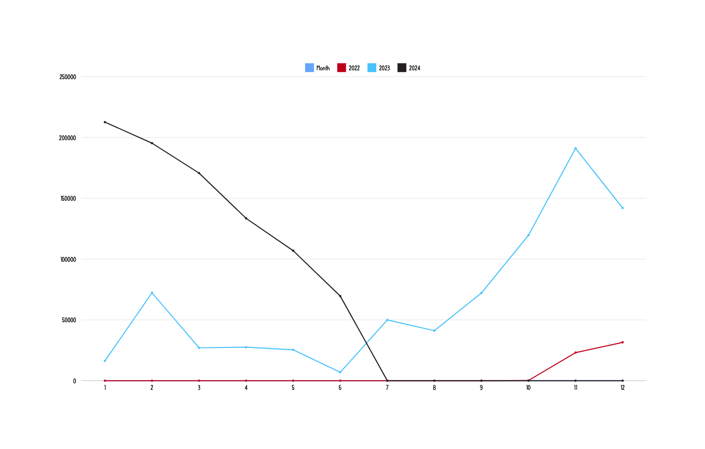
Trends
Raw Sales
(2022-June 2024)

Slide 13
Trends
Summary:
2022 - Upward Trend| +6107.63% in Raw Sales per month
Start of consistent live selling
Peak season (Holidays/Christmas in The Philippines)
2023 - Upward Trend| +89.14% in Raw Sales per month
Decline in the first half of the year due to preparation for physical store
Major upward trend in the second half, focusing on live selling once again and preparation for peak season.
2024 - Downward Trend| -19.47% in Raw Sales per month
Suspected reason: our shop’s vacation in March and nothing new to offer for customers.
Solution: Introduce a service-based product. Start small with either crafts or fixing things.

Slide 14
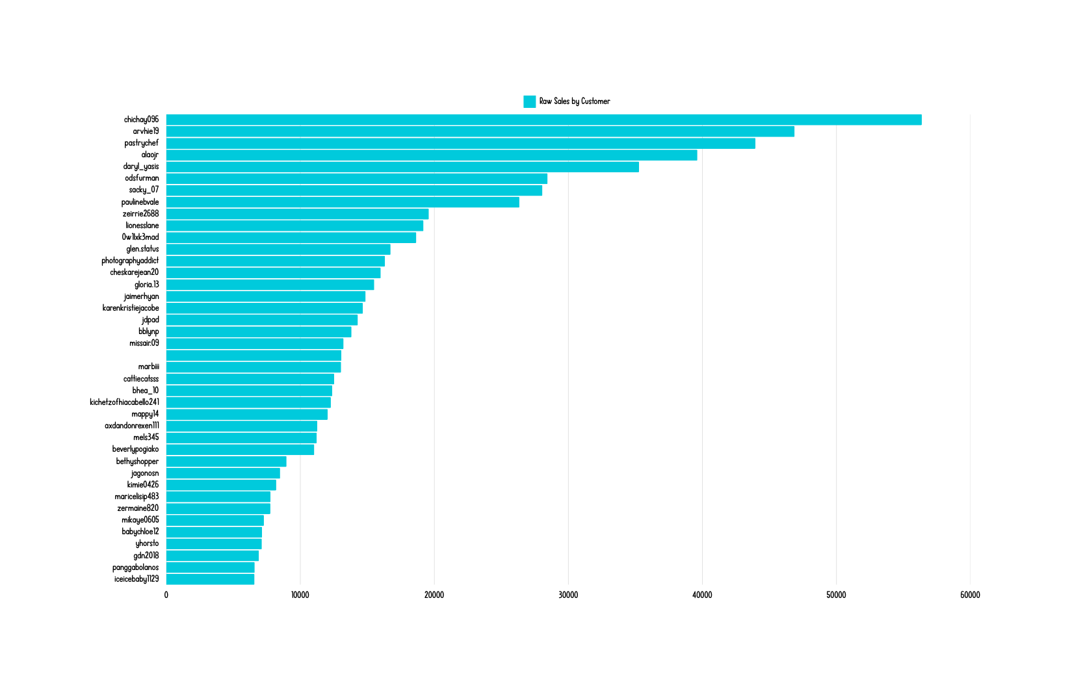
Top Sales by Customer

Slide 15

Top Sales by Customer
POWER 4%
These are my clients who are actually my target who can make my company filthy rich
- Sabri Suby, Sell Like Crazy
These top 40 shown in the chart is not just a random number, these are people we have to take extra care of. Make them feel extra special.

Slide 16
Top Sales by Customer
Goal:
Discover their pattern similarities
Discover how we can reach the same type of people.
Pattern similarities:
What do they usually order?
What do they search?
What age are they?
Current action plan:
Treats when it’s Christmas or Holidays
Freebies when they cross a certain threshold
Suggested next steps:
Acquire their date of births
Ask about their hobby/interest

Slide 17
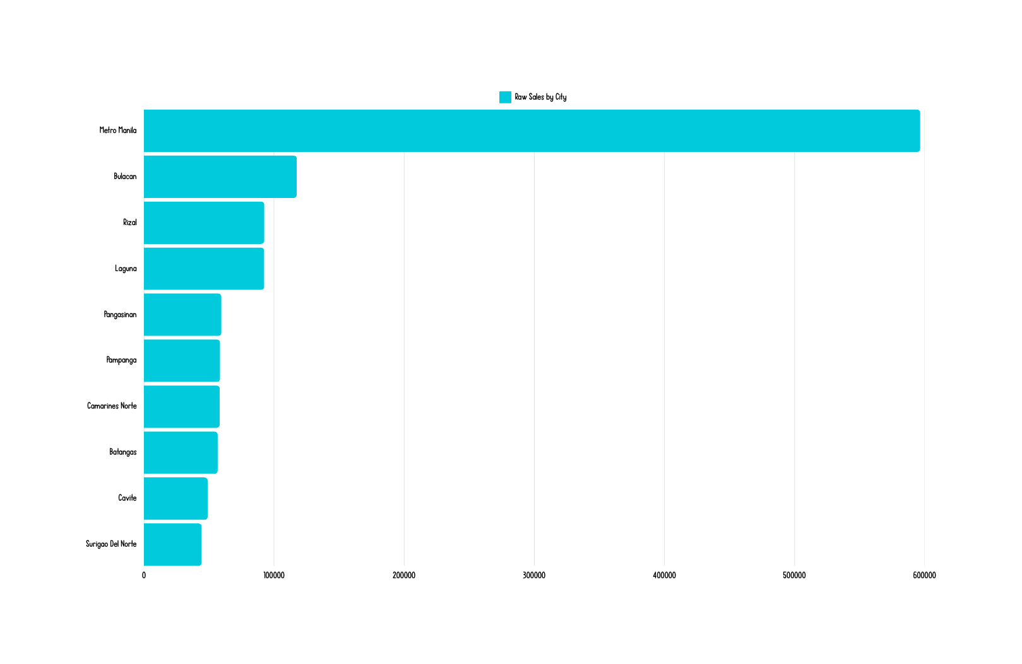
Top Sales by City

Slide 18
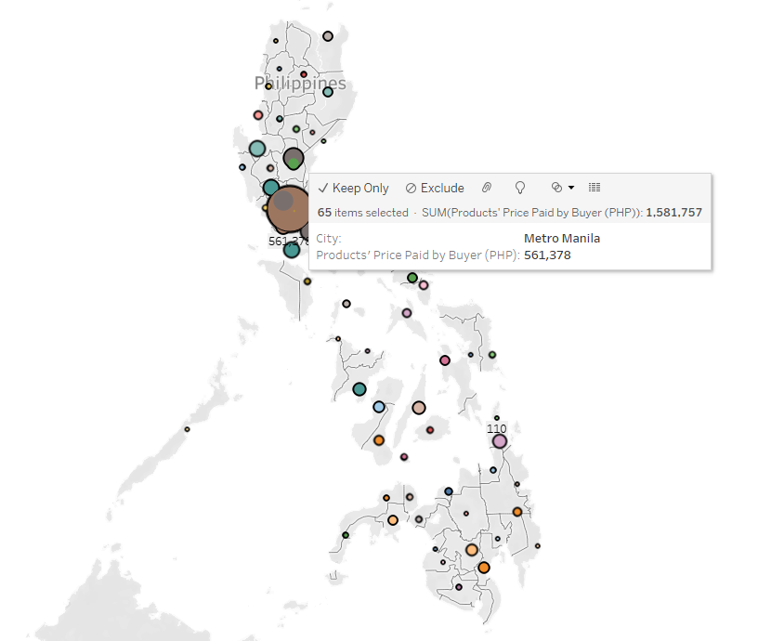

Top Sales by City

Slide 19
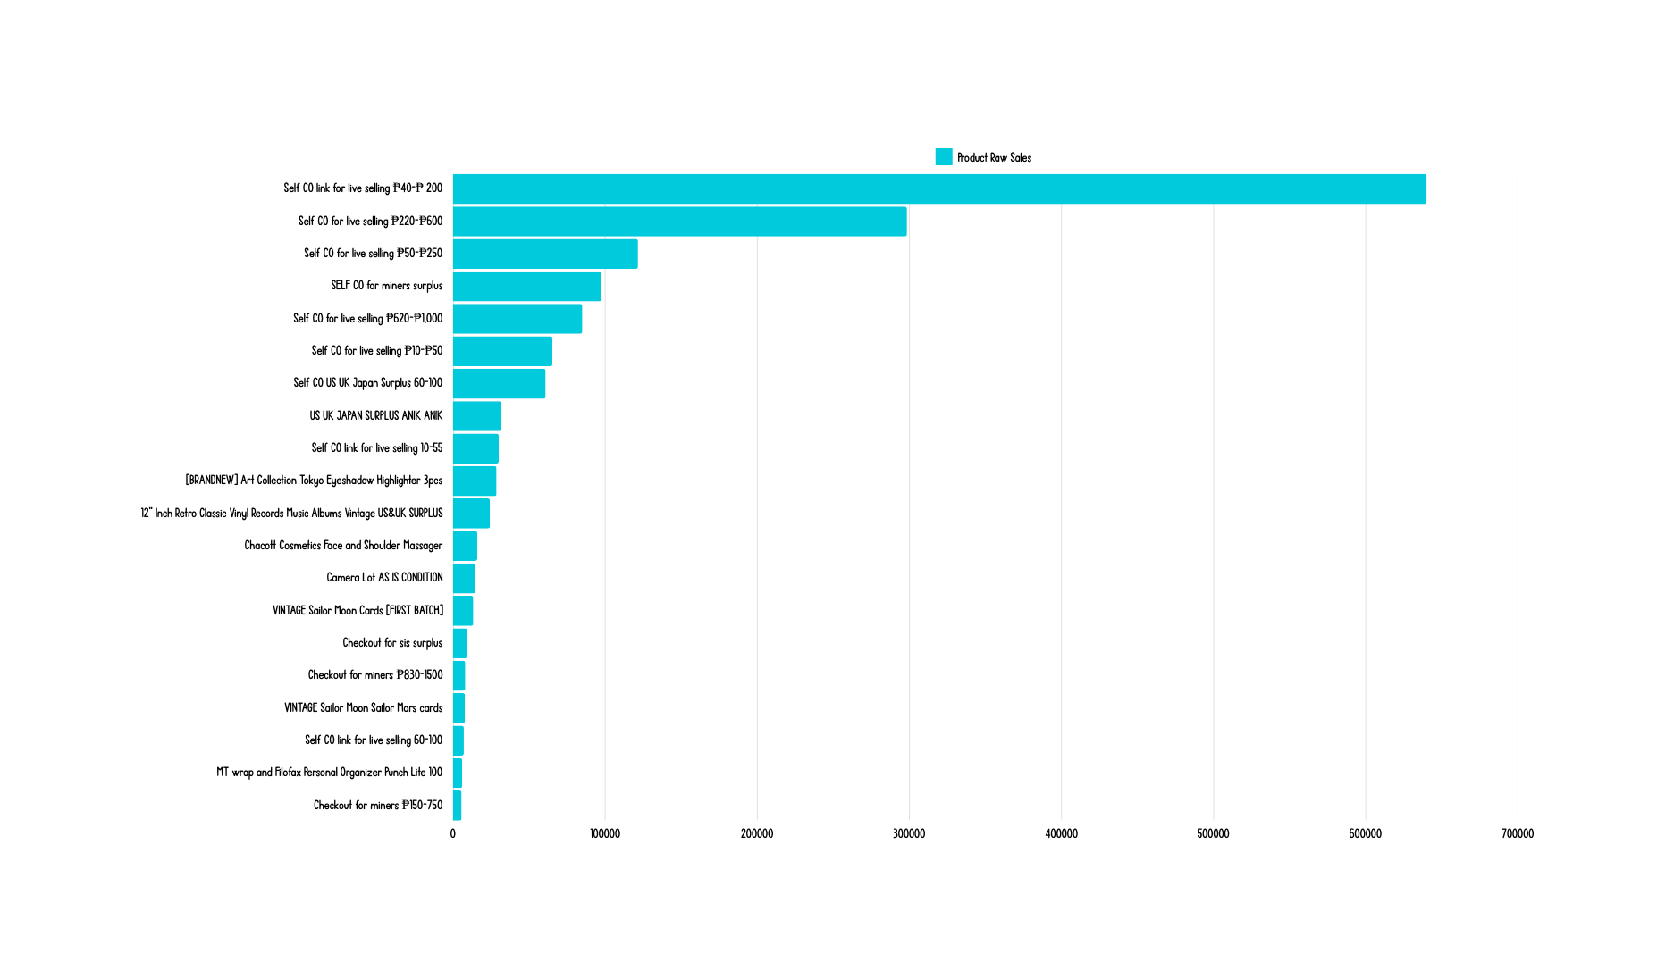
Raw Sales by Product

Slide 20
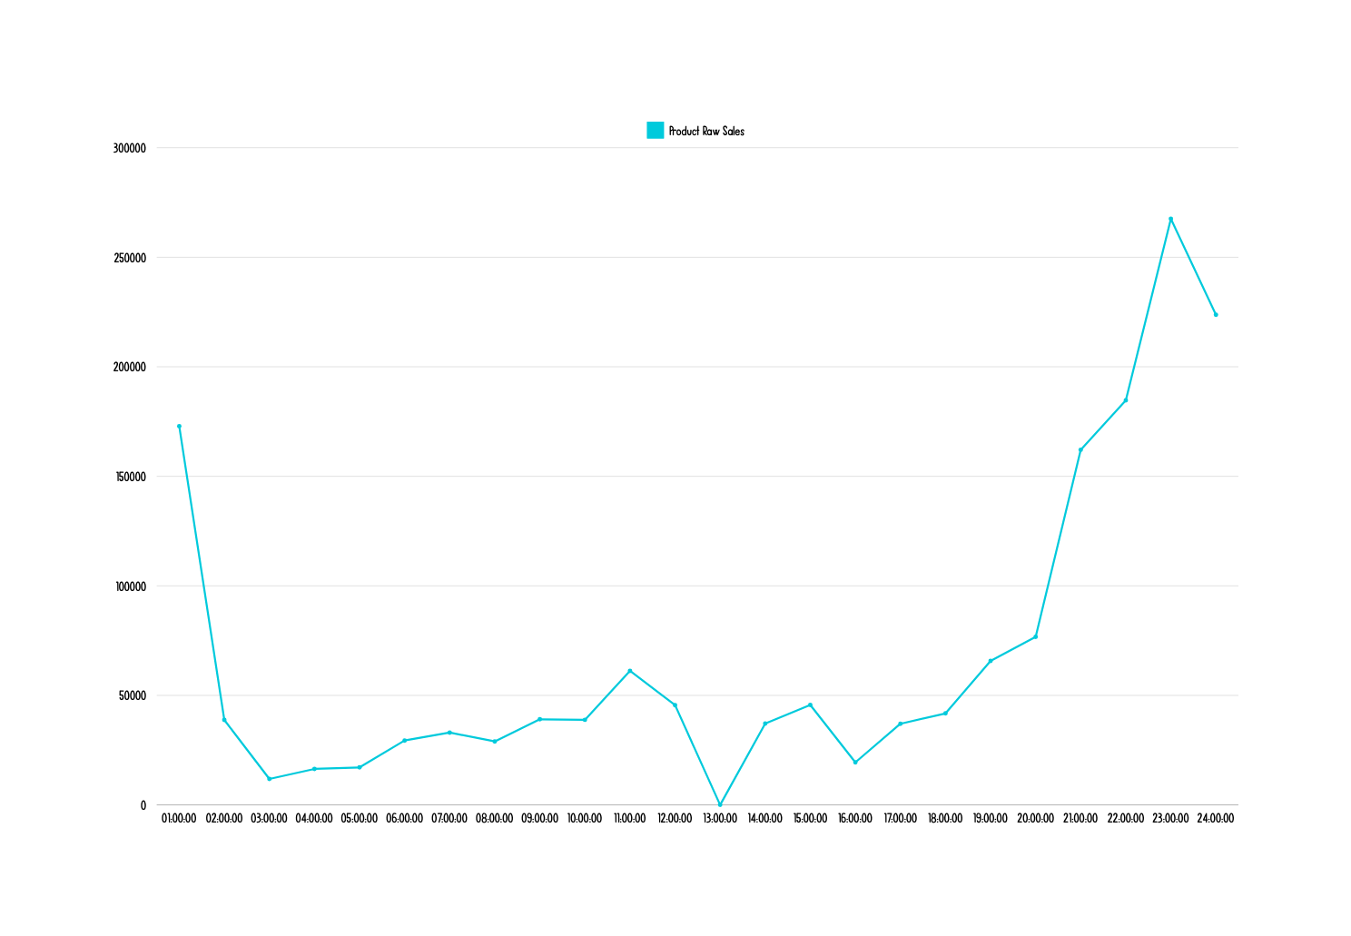
Raw Sales by Time

Slide 21
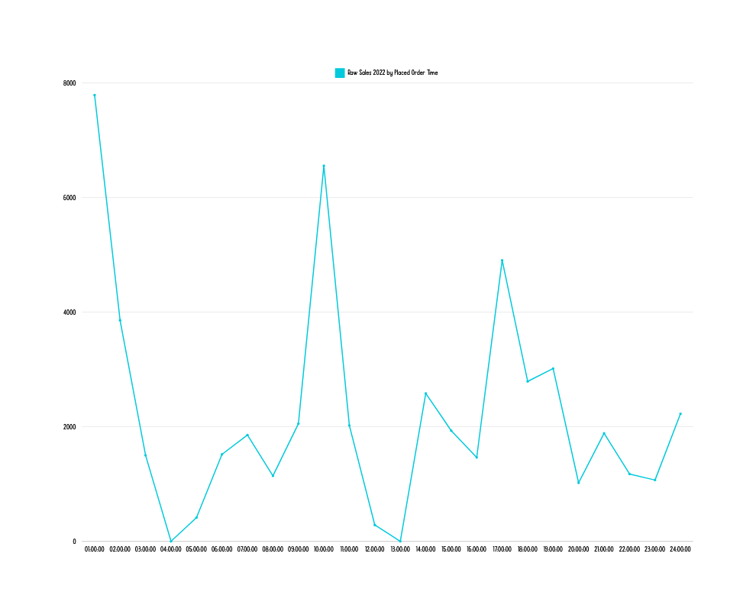
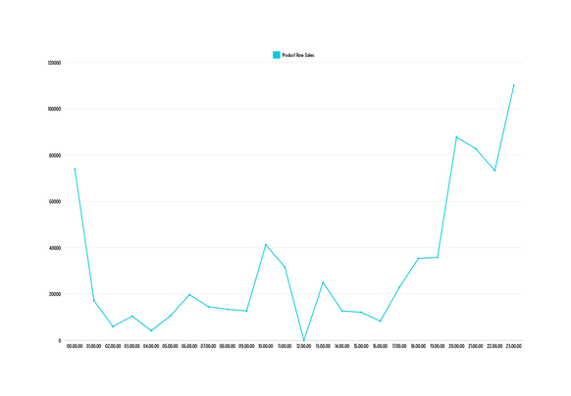
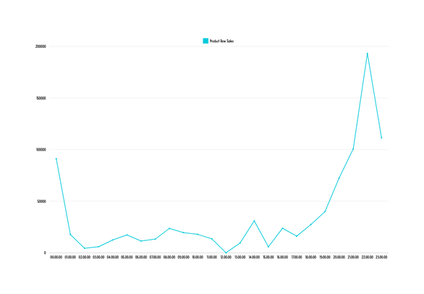
Raw Sales by Time
2023
2022
2024

Slide 22

Raw Sales by Time
Bad Representation
2022

Slide 23
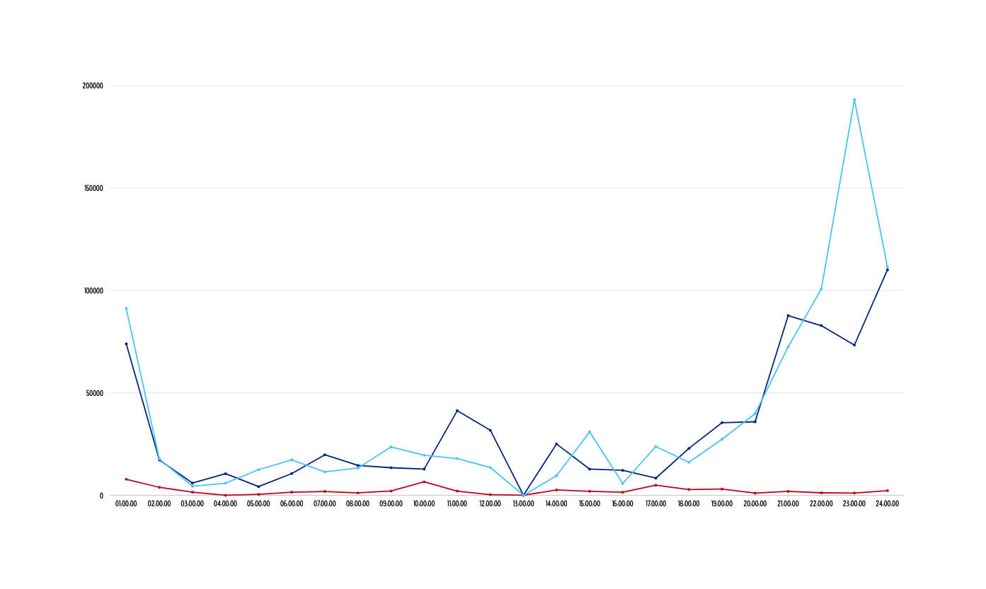

Superimposed Raw Sales by Time
2022-2024

Slide 24
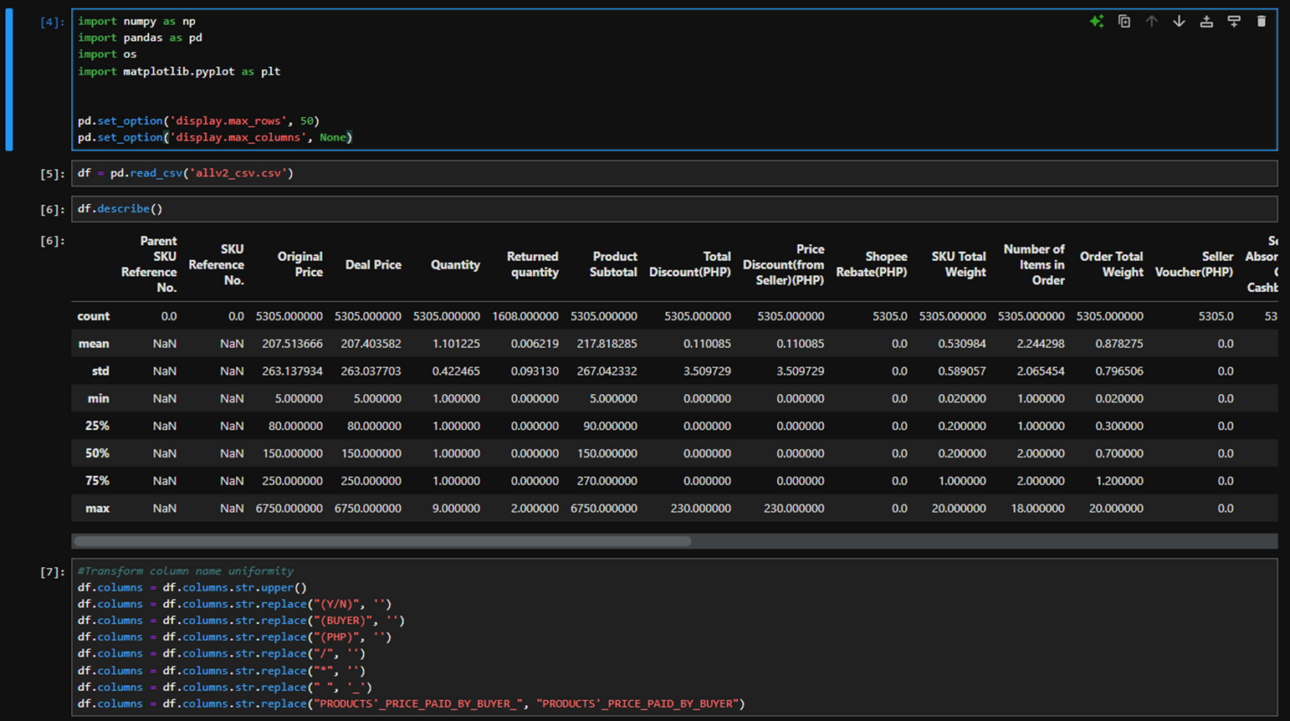
Sample Python Work

Slide 25
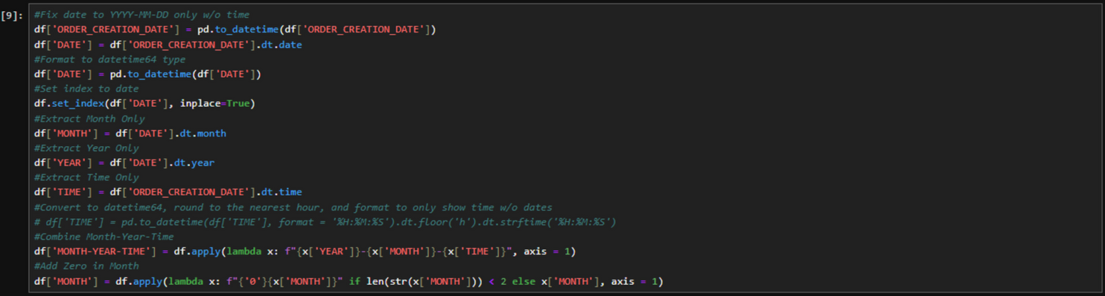
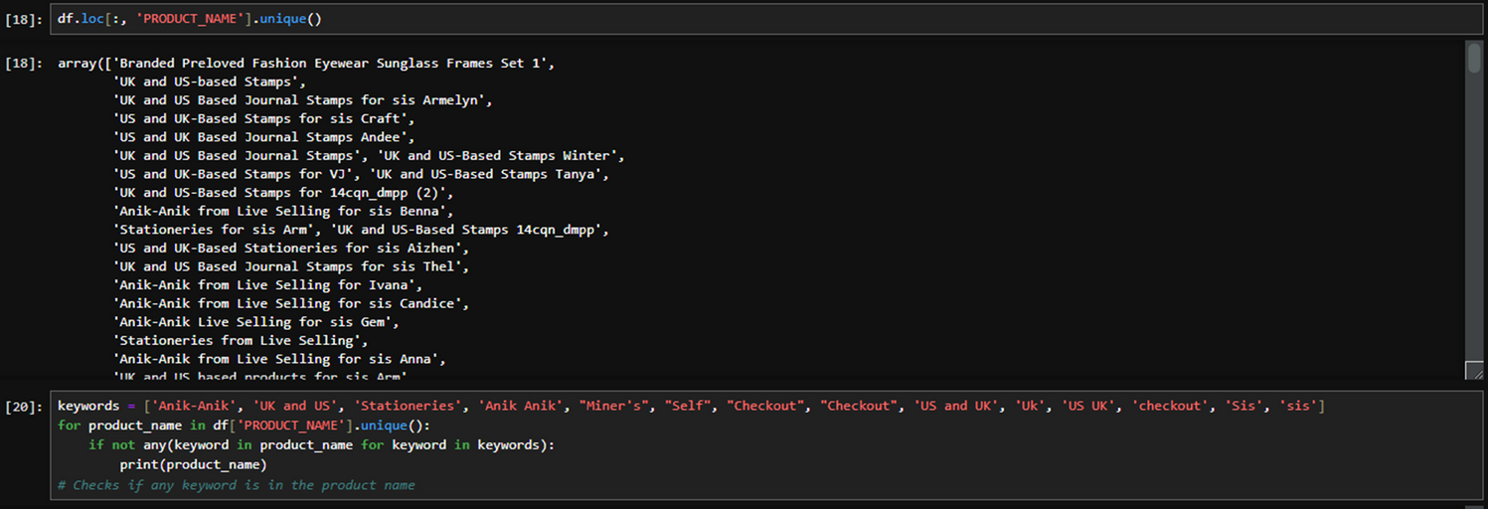
Sample Python Work

Slide 26
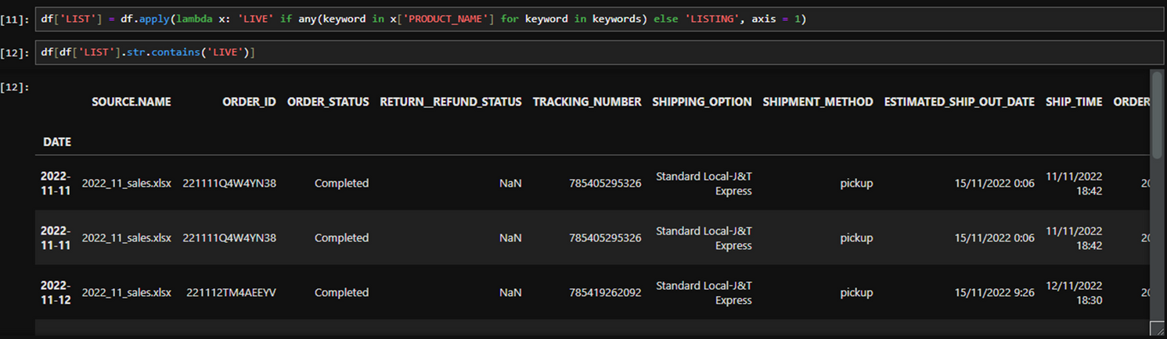
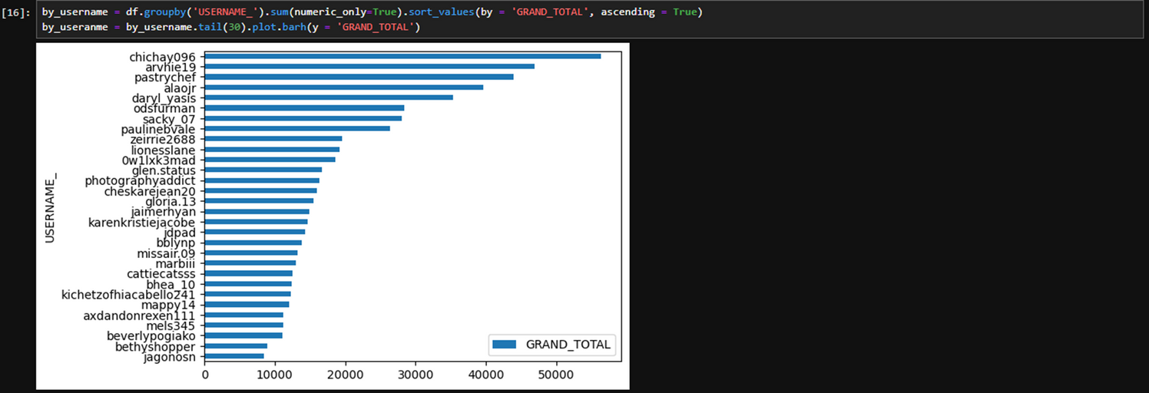
Sample Python Work

Slide 27
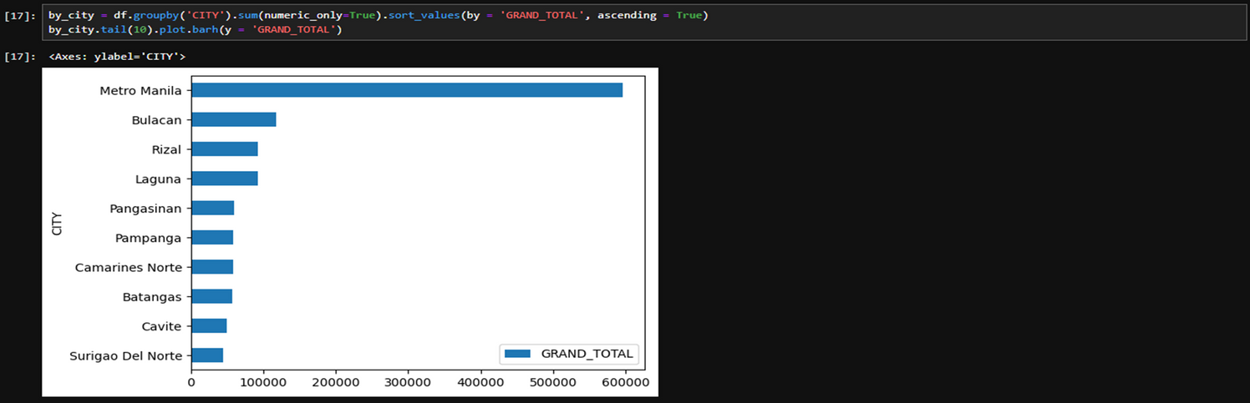
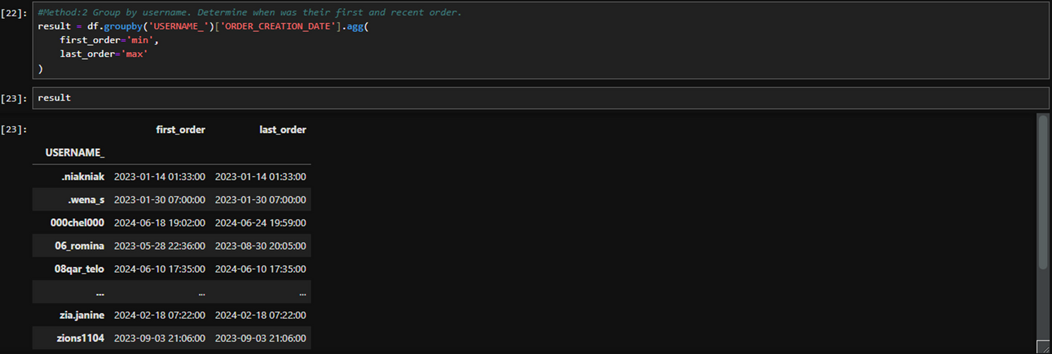
Sample Python Work

Slide 28



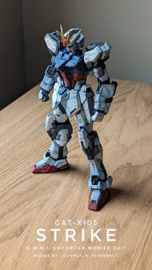
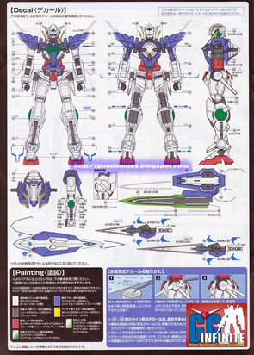
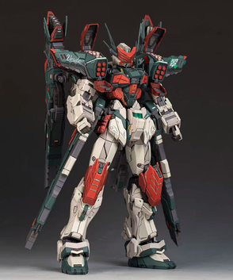
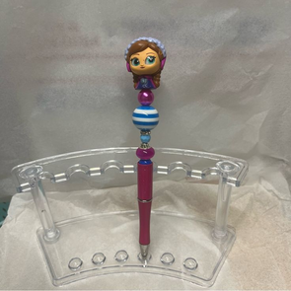
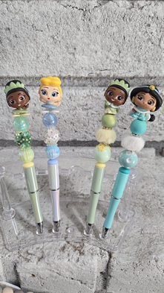
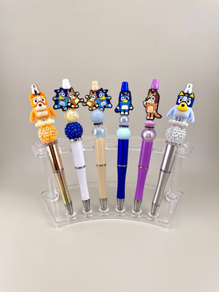
Introduced New Product:
Existing market research result:
Art Commissions
2. Gundam / Gunpla build service
3. Customized character pens
=> Sold on various art sites
and facebook groups
=> Customer will buy the gundam kit. We build it for them.
=> Customer will pick which characters they like and also pick from all available design

Slide 29
Introduced New Product:
Customized Pens
Mechanics:
Customer will pick their character topper (e.g., Winnie The Pooh, Labubu, etc.,) in the comment section before they get their turn to customize.
A customer has 20 minutes to pick which body and beads they want. This policy is meant to cater to other customers as well.
Customers must check out the item in Shopee within 3 days or the item will be sold as a pre-built item in the Shopee page’s listings.

Slide 30
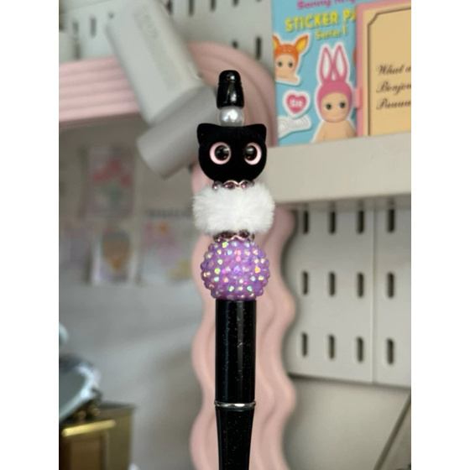
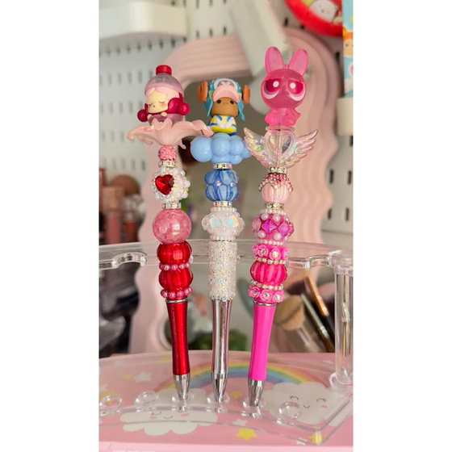
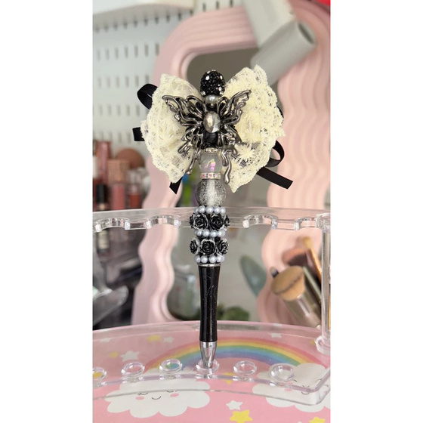
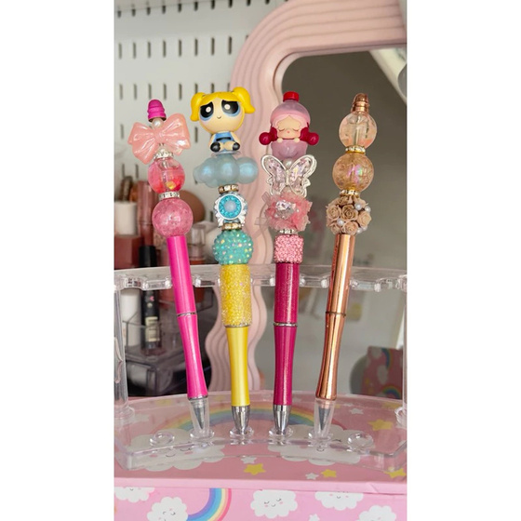
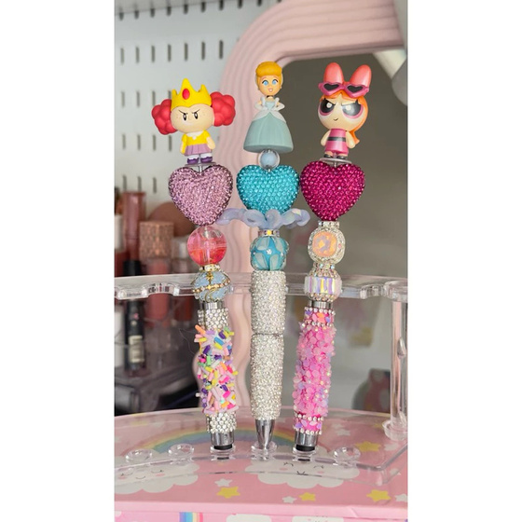
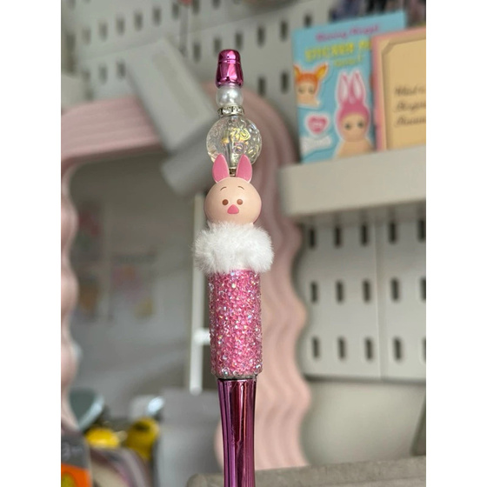
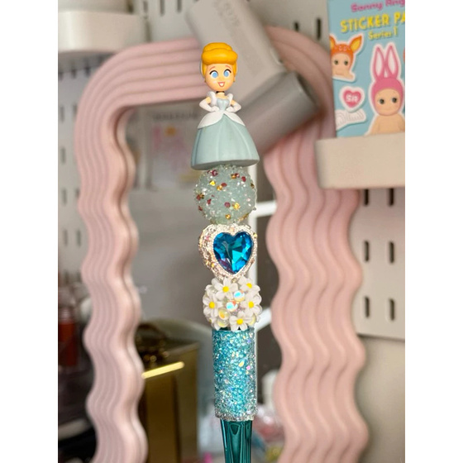
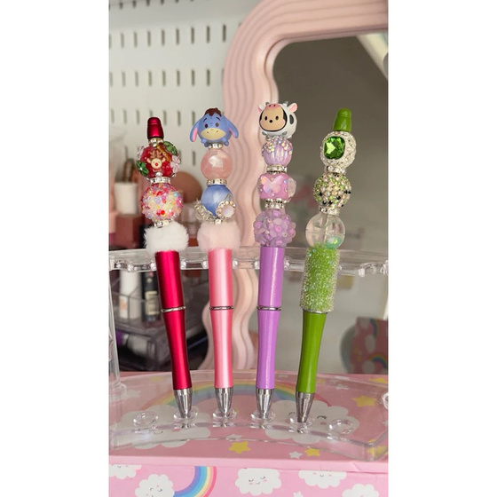
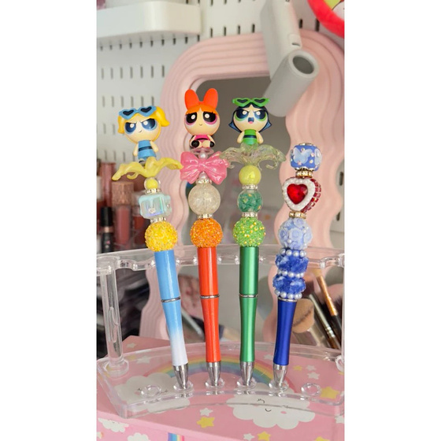
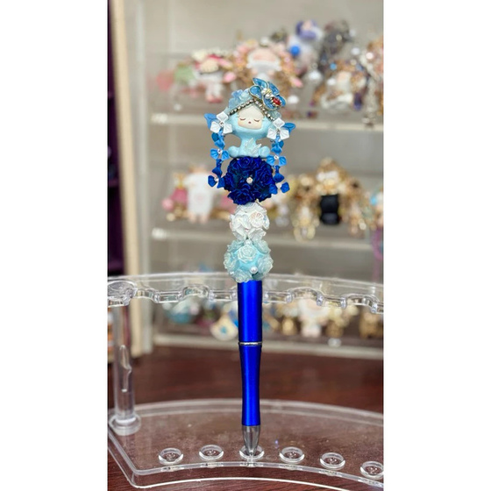
Customized Pens

Slide 31
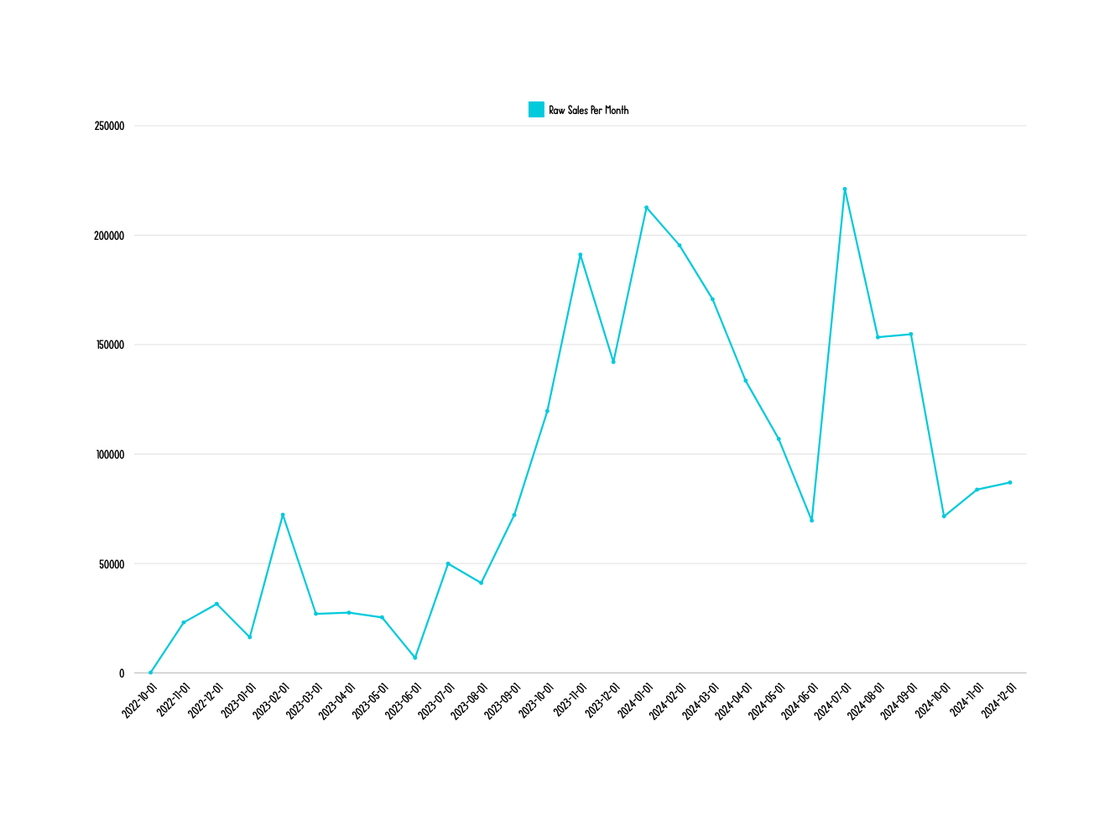
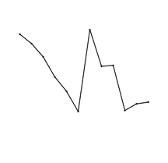
Updated Trend
Raw Sales
2022
Raw Sales
2023
Raw Sales
2024
Raw Sales
(2022- 2024)

Slide 32
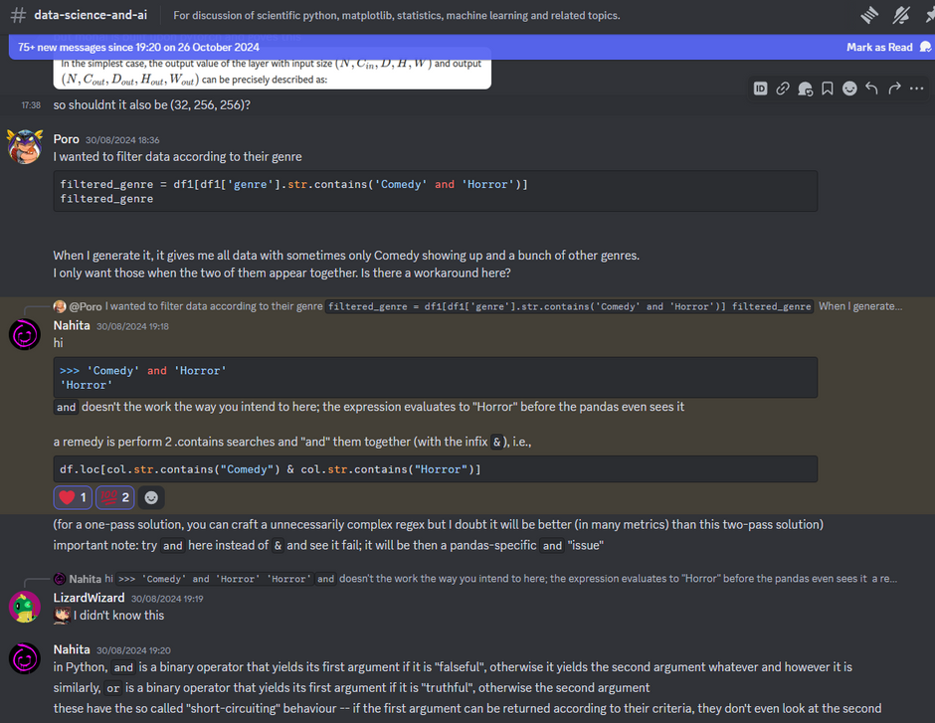
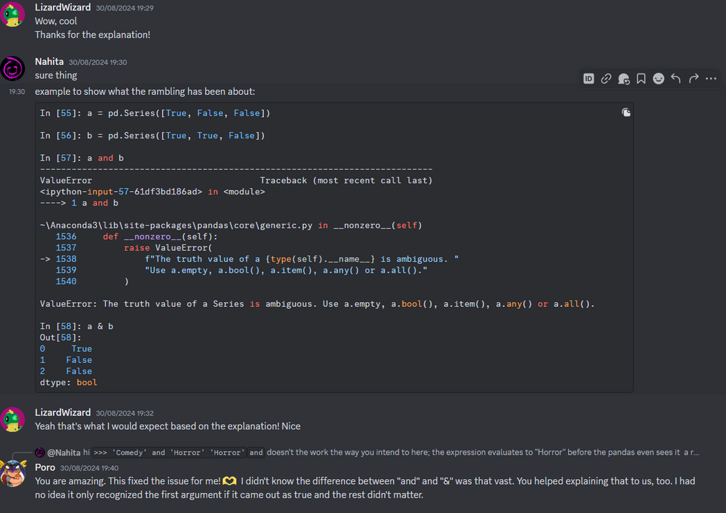
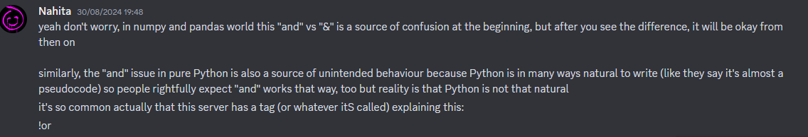
Community Help

